Slide 1
Multimedia Class 2016 TA Class
Slide 1:
Introduction to Image Processing using MATLAB

Slide 2
Outline
Introduction to MATLAB
Basics and examples
Introduction to Image Representation in MATLAB
Basics and examples

Slide 3
Why MATLAB?
MATLAB = Matrix Laboratory
MATLAB is a high-level language and interactive environment that enables you to perform computationally intensive tasks faster than with traditional programming languages such as C, C++ and Fortran.
MATLAB is an interactive, interpreted language that is designed for fast numerical matrix calculations
A huge amount of Toolboxes and Code samples (Check out your MATLAB Help)
A de facto standard framework for academic advancements

Slide 4
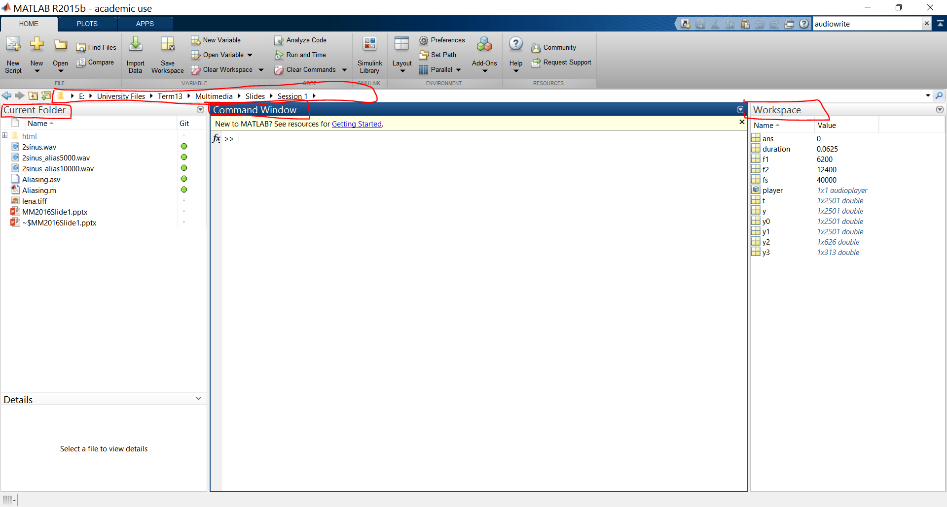

Slide 5
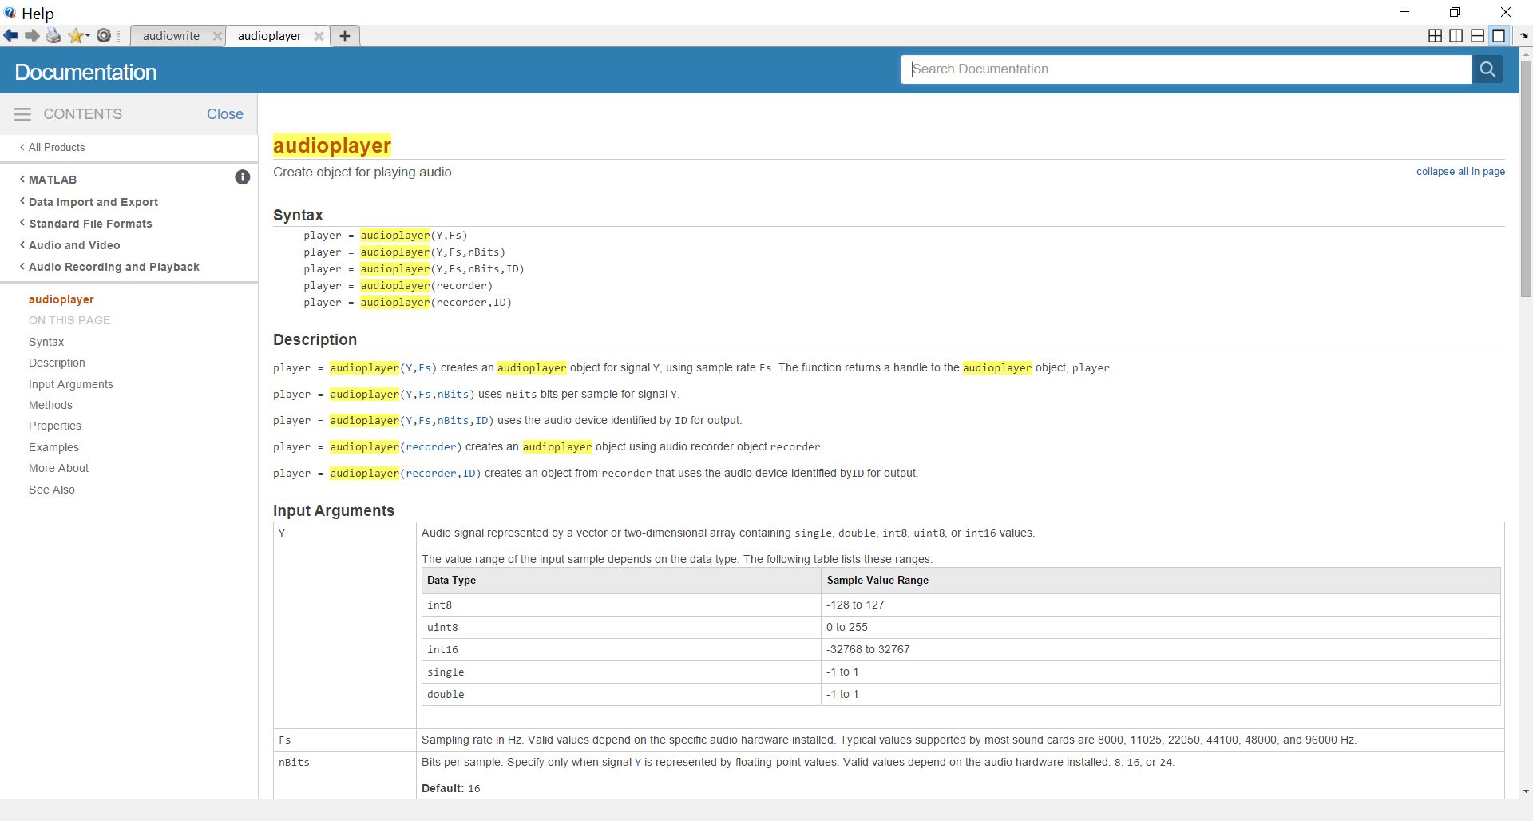

Slide 6
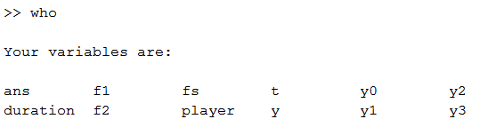
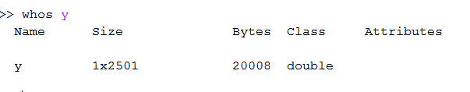
MATLAB Basics
To find out the type and value of a variable you are using: who, whos
Saving and loading variables to *.mat files: save, load
A good practice to include in your files before doing anything:
clear all, clc, close all, fclose all;

Slide 7
MATLAB Basics
Main matlab variable type: Matrix
Creating matrices:
A = [1 2 3; 4 5 6; 7 8 9]
Special Matrices: zeros, ones, rand, randn, eye
Finding size of matrix: size(A) = [3 3]
Sum(A), sum(A, 2), sum(sum(A))
CODE
Finding something in a matix:
Find(A < 4)

Slide 8
Control statements
If statement
Switch statement
For loop
While loop
Continue
Break
End
Whenever in doubt, use MATLAB Help

Slide 9
M-Files
There are 2 kinds of *.m files
Functions
Well, you should know what functions are, if not, Google it ☺
We will get into more details later
Scripts
Scripts are simple MATLAB code that will be run line by line
It’s like you would run them line by line in command window

Slide 10
Let’s get to business
Check the MATLAB Code

